Slide 1




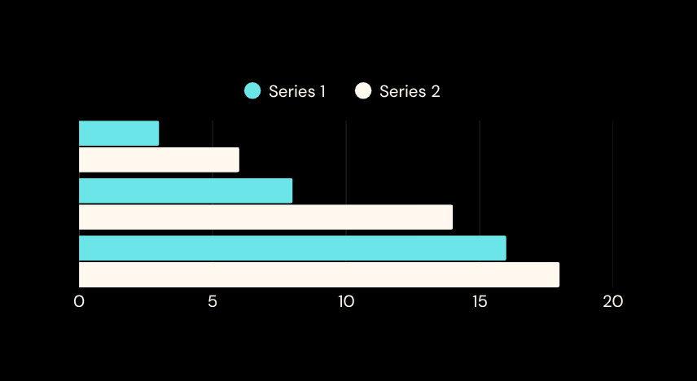
CHILL & HEAL
REVENUE GROWTH DASHBOARD
Excel Based MIS & Data Analysis Project
Prepared by:
Tool Used:
Pranav Chavan
Microsoft Excel

Slide 2
Introduction
Chill & Heal is a wellness service company that provides professional massage therapy services in collaboration with hotels and corporate locations.
The business employs trained therapists and offers different types of therapeutic massage services such as Ayurvedic Massage, Thai Massage, Swedish Massage, Deep Tissue Massage, and Foot Reflexology.
The company operates on a service-based revenue model where hotels or customers book therapy sessions and therapists are assigned accordingly.
To track business performance, therapist productivity, service demand, and revenue generation, a structured Excel-based MIS Dashboard was developed.
This dashboard helps the company monitor operations and take better business decisions.

Slide 3
Problem Statement
Before creating this dashboard, the company faced several operational challenges:
• Service data was recorded manually without structured analysis
• Difficulty in tracking therapist performance
• No clear visibility of revenue from each hotel partner
• No insights into which massage services were most popular
• Time consuming process to analyze monthly business performance
Due to these issues, decision making was slow and business insights were limited.

Slide 4
Objectives of the Project
The main objective of this project was to build a dynamic Excel MIS Dashboard that can analyze business performance.
Key objectives include:
• Organize raw service transaction data into a structured dataset
• Track revenue generated from different massage services
• Analyze hotel-wise revenue contribution
• Monitor therapist performance and service count
• Identify top performing services and partners
• Create an interactive dashboard using Pivot Tables, Charts and Slicers
The final dashboard allows quick filtering and visual analysis of the entire dataset.

Slide 5

Data Overview & Dataset Information
Dataset Fields
Dataset Size
Transaction ID – Unique identifier for each service
Date – Date on which the service was performed
Month – Month of the transaction for time-based analysis
Hotel Name – Hotel partner where the service was provided
Customer ID – Unique identifier for customers
Therapist Name – Therapist who performed the service
Service Type – Type of massage service provided
Price – Service price charged to the customer
Therapist Payment – Payment given to the therapist
Company Profit – Profit retained by the company
Total Records: 500+
Total Services: 9
Total Therapists: 10+
Partner Hotels: Multiple Hotels
Time Period: Jan 2025 – May 2025
No of Sheets : 6 Sheets

Slide 6
Data Cleaning & Preparation
Key Data Cleaning Steps :
• Date Standardization – Mixed date formats were converted into a consistent Excel date format for proper time-based analysis.
• Duplicate Customer Identification – Conditional formatting was applied to highlight duplicate Customer IDs, helping identify repeat customers.
• Conditional Formatting – Applied to important columns such as Service Type, Price, and Company Profit to visually highlight key data patterns.
• Data Validation Columns Added – Two additional columns were created to verify data accuracy:
Service Price Check – Validates service pricing
Profit Validation – Ensures profit is calculated correctly
(Profit = Service Price − Therapist Payment)
These steps helped prepare a clean and reliable dataset for building the analytical dashboard.

Slide 7
Dashboard KPIs
The dashboard was designed to track key business performance indicators.
Main KPIs included:
• Total Revenue Generated
• Total Services Performed
• Total Company Profit
• Average Revenue per Service
These KPI cards provide a quick overview of business performance and help management understand overall business growth.

Slide 8
Key Insights
Based on the analysis, several important insights were identified:
• Certain massage services generate higher revenue compared to others
• A few partner hotels contribute a significant portion of total revenue
• Some therapists perform significantly more services than others
• Revenue trends fluctuate depending on month and service demand
These insights help the company optimize therapist allocation and focus on high demand services.

Slide 9
Business Impact
The Excel dashboard helps the company in multiple ways:
• Real-time visibility of business performance
• Faster analysis of service demand and revenue
• Improved tracking of therapist productivity
• Better understanding of hotel partnership performance
• Data driven decision making for business expansion
This solution transforms raw service data into meaningful business insights.

Slide 10
Conclusion
This project demonstrates how Microsoft Excel can be used as a powerful tool for business analytics.
By organizing raw operational data and creating an interactive dashboard, the company can now monitor performance efficiently.
The dashboard simplifies complex data and provides clear visual insights that support operational and strategic decision making.

Slide 11
Future Enhancements
The dashboard can be further improved with additional features such as:
• Integration with Power BI for advanced visualization
• Automated data updates using Excel Power Query
• Forecasting future revenue trends
• Customer feedback analysis
• Profit margin analysis for different services
These enhancements can further improve business intelligence capabilities.

